Slide 1


Topics In Computer Science - II
SESSION 2021- 2025
FACE RECOGNITION SECURITY SYSTEM
Innovative AI for Real-Time Facial Identification
DEPARTMENT OF COMPUTER SCIENCES COMSATS UNIVERSITY ISLAMABAD, WAH CAMPUS WAH CANTT – PAKISTAN

Slide 2



Topics In Computer Science - II
SESSION 2021- 2025
GROUP MEMBERS:
YAHYA HUSSNAIN
REG. NO. CIIT/FA21-BCS-071/WAH
WAQAR HUSSAIN SHAH
REG. NO. CIIT/FA21-BCS-074/WAH
DEPARTMENT OF COMPUTER SCIENCES COMSATS UNIVERSITY ISLAMABAD, WAH CAMPUS WAH CANTT – PAKISTAN

Slide 3
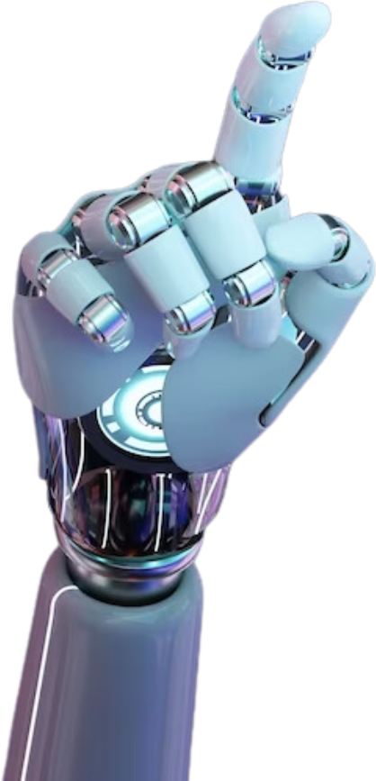

Topics In Computer Science - II
Introduction
Real-Time Facial Authentication: A secure application leveraging facial biometrics for identity verification.
AI-Driven Recognition: Uses state-of-the-art computer vision models (e.g., YOLO) for high-accuracy detection.
Multi-Platform Deployment: Works seamlessly across CCTV, web cams, and mobile devices.
Security Enhancement: Replaces traditional methods (passwords, ID cards) with biometric authentication.
Use Cases: Office entry systems, attendance tracking, ATM authentication, and public security.

Slide 4
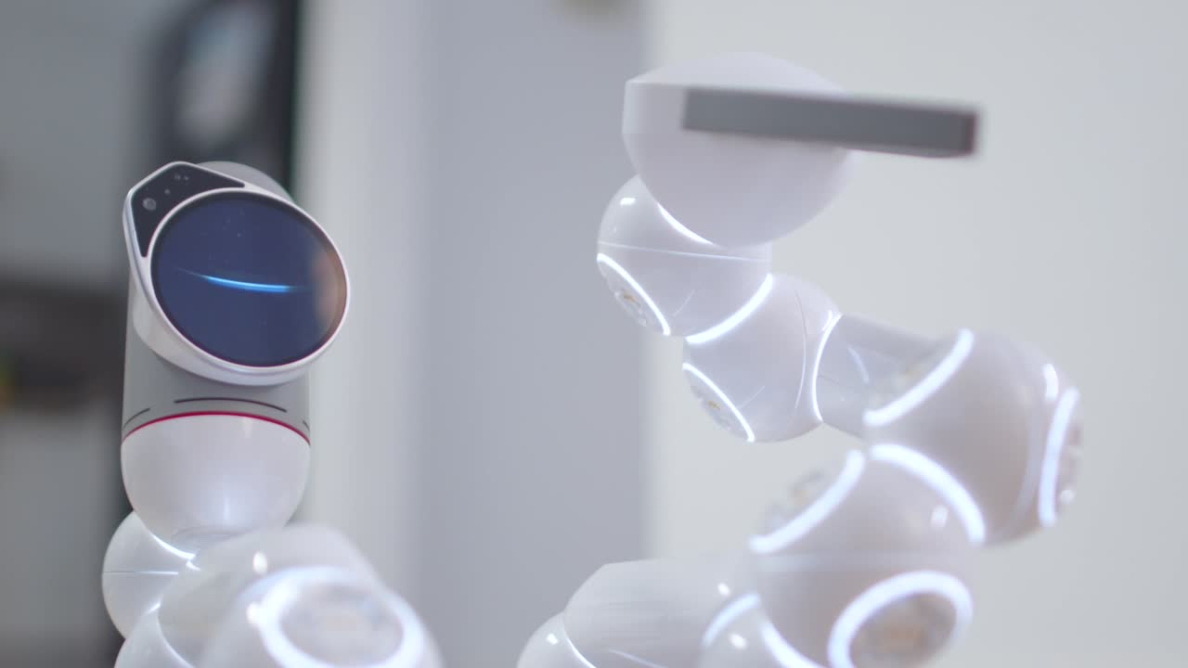

Topics In Computer Science - II
Problem Statement
Weakness of password-based security systems
Vulnerability of RFID or manual attendance systems
Identity fraud risks in public spaces
Lack of scalable, non-intrusive real-time monitoring
Need for fast, accurate, and contactless verification methods

Slide 5


Topics In Computer Science - II
Objective & Impacts
Objectives
Impacts
Enhances physical and digital security
Minimizes impersonation and identity theft
Reduces manual labor in attendance and surveillance
Encourages adoption of biometric technologies in developing systems
Enable real-time facial recognition with high precision
Integrate authentication with user databases
Provide multi-user detection and logging
Ensure system works in diverse lighting and angles
Maintain secure, encrypted access logs

Slide 6




Topics In Computer Science - II
Technologies
Face Detection & Recognition: YOLOv8 for detection;
Backend: Python on Jupyter Environment for system control and authentication
Frontend: React JS / HTML5 for UI Dashboard
Database: PostgreSQL for storing embeddings and logs
Camera Integration: OpenCV for real-time stream processing
Deployment: Runs on PC or NVIDIA Jetson Nano for embedded systems

Slide 7
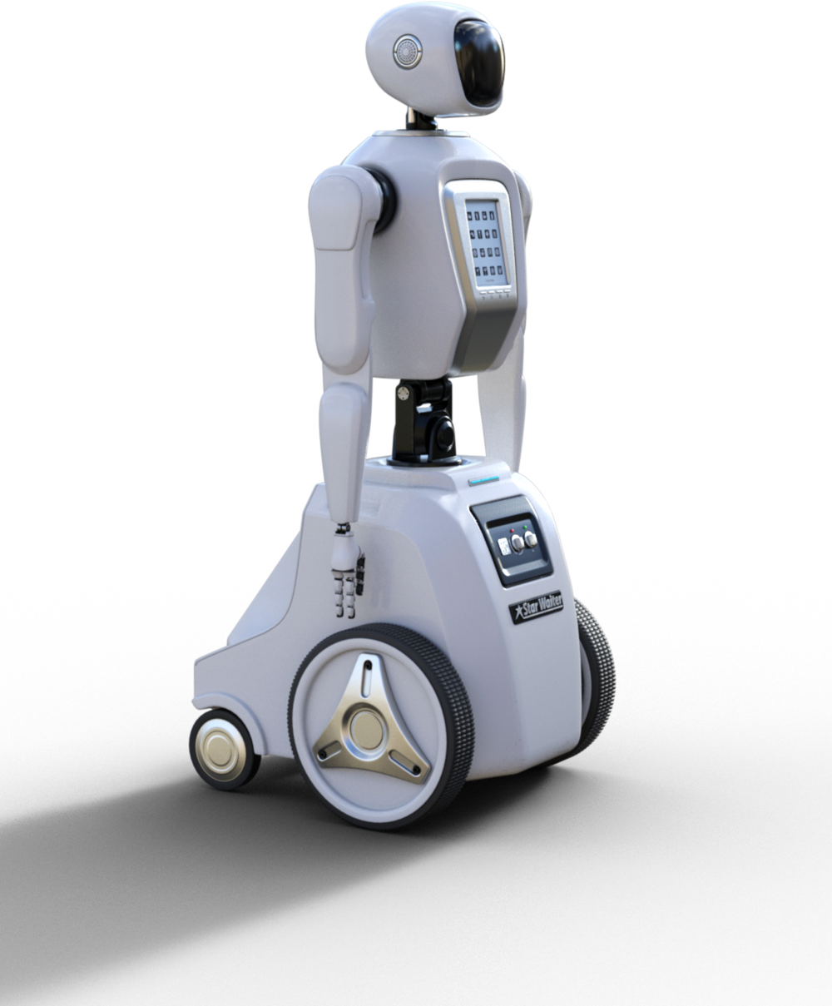
Topics In Computer Science - II
Benefits & Features
Touchless Authentication
Real-Time Detection & Logging
High Accuracy with Deep Learning Models
Role-Based Access Control (Admin/User)Face Database Management Interface
Alert System for Unknown Faces
Time-Stamped Attendance Reports

Slide 8

Topics In Computer Science - II
Feature Overview Table

Slide 9
Module | Key Functionality
Face Detection | Locates faces in video or images
Face Recognition | Matches faces to existing user database
Admin Dashboard | Manage users, logs, and reports
Live Monitoring | Real-time camera feed with overlays
Alert System | Notifications for unknown or multiple entries
Report Generation | Daily/Monthly attendance reports

Slide 10
Topics In Computer Science - II
Before vs. After Facial Recognition
Challenge | How SoulSync AI Solves It
Manual check-in logs | Automated, real-time attendance
Password-based systems | Face-based authentication
Identity fraud risks | Biometric accuracy
Time-consuming verifications | Instant access control
Vulnerable security | Smart, camera-based alerts

Slide 11
Topics In Computer Science - II
Real-World Use Cases
Office Entry & Attendance
Classroom Roll Call System
ATM or Smart Lock Security
Airport and Public Surveillance
Hotel Self-Check-In
Exam Hall Authentication
Input your Suggestions

Slide 12
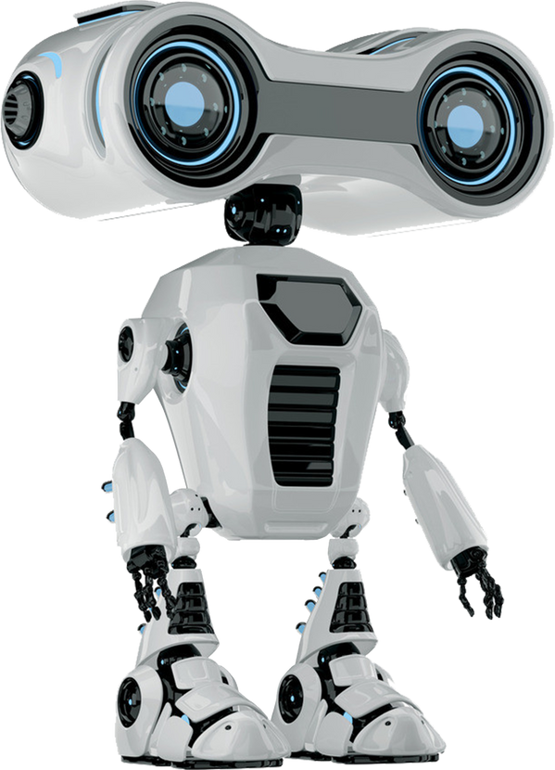
Topics In Computer Science - II
Thank You

